Slide 1
Project: Crime Analyzer
Course: Foundation of Data Science
Program: MSc (Data Science)
Academic Year: 2015/16
Team 5: 1. Miguel Ballesteros (mabm1e15)
2. Alun Meredith (am5e15)
3. Taoufik El Khiraoui (tek1g15)
4. Manu Llamas (mlf1g15)
5. Ali Shah (smas1c15)

Slide 2
Agenda
Scenario
Ideas
Project Scope
Application Demo
Technical Implementation
Data Collection
Data Cleansing/Pre-processing
Data modelling
Data Visualization
Conclusion

Slide 3
The idea
Populate crime data on UK map and predict risk zones
Sentiment Analysis of Tweets related to UK News
Populate crime data on London map and compare with other same size cities.
Populate crime data on London map and perform exploratory analysis
Notes:
During the brainstorming session, there were many ideas generated, but after careful evaluation and keeping the time and skillset in mind we shortlisted these four ideas.
Populate the crimes on UK map and find patterns to predict the potential crime risk in that area.
To perform sentiment analysis using Twitter and News data.
The team decided to merge the two ideas and reduce the scope from whole UK to London and to perform sentiment analysis of tweets related to crime only.
However, due to limitation in data granularity, inconsistency and not enough valid tweets available for specific crime, the team decided to redefine the scope and selected the option 4 i.e., “to populate crime data on London map and perform exploratory analysis”.

Slide 4
The project scope
Populate crime data on London map
and
perform exploratory analysis
Notes:
Idea Justification
The team is highly motivated that this project is challenging and will give us an opportunity to utilize the programming, data modelling and analytical skills.
The team is highly convinced that this application will help a common person to know the crime rate.
In future the unique feature will be that this application will give an opportunity to understand the relationship of crime with respect to weather, population, literacy rate, income level, unemployment level, poverty rate, deputed police force and so on.
Depends on the availability of datasets, we MAY incorporate cybercrime in this application.
I would like to request my colleague Miguel and Taoufik to give demo of this application.

Slide 5
Technical implementation

Slide 6
Data Collection

Slide 7
Data Cleansing/Pre-Processing

Slide 8
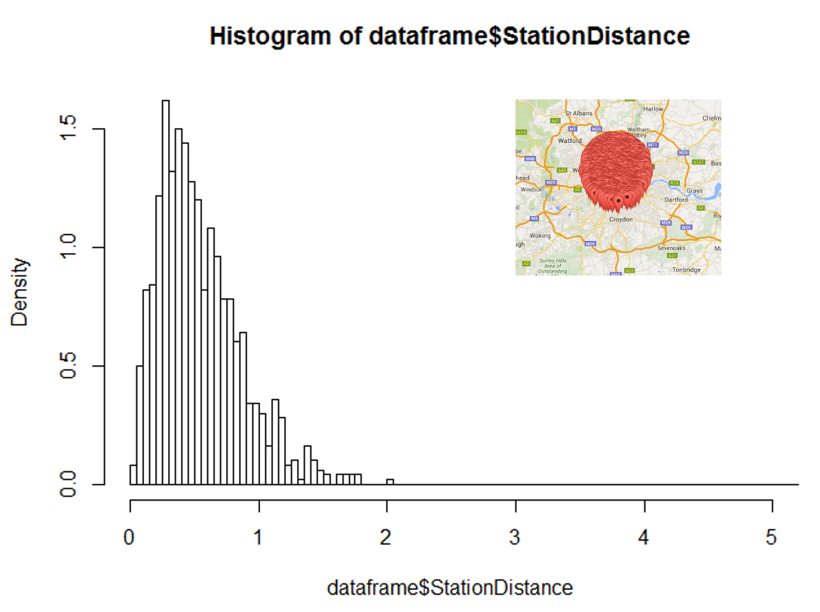
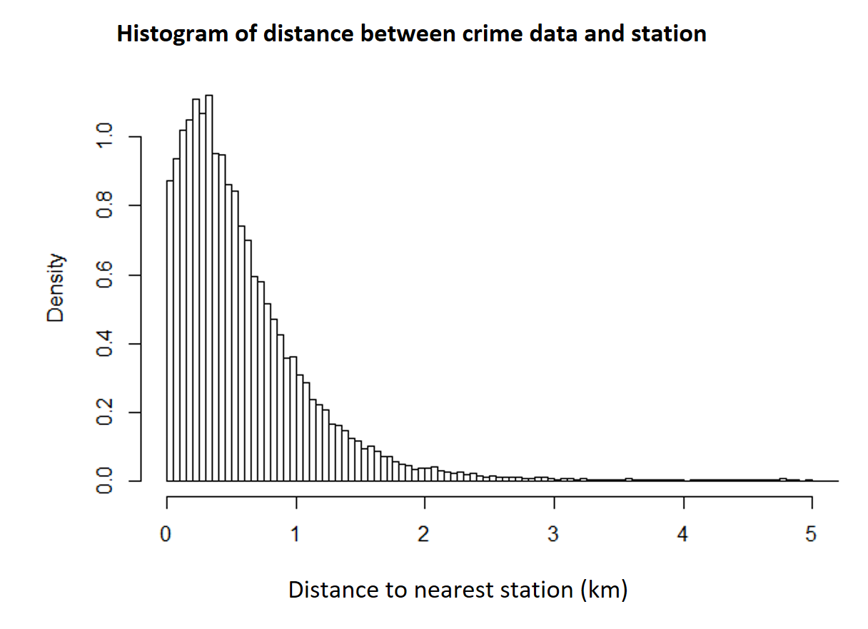
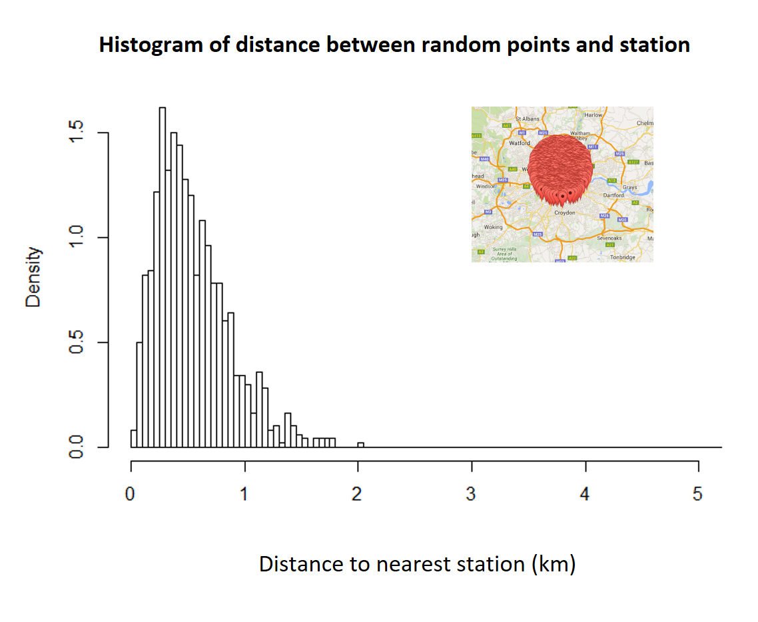
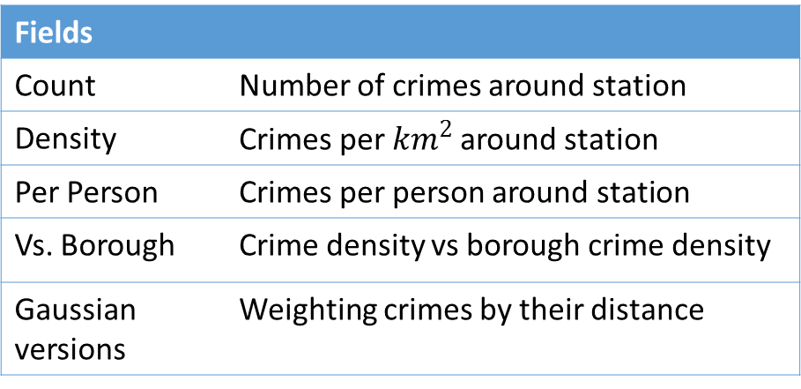
Data Modelling
Goal: Analyse the effect of points of interest on crime rates. Visualising the effect of those points on crime.
Process:
Calculate distance to nearest station.
Find number of crimes per station in circle.
Apply Gaussian weighting.
Calculate area of circle removing overlap
Find number of stations and distances to those stations within circle diameter.
Divide by Area / Borough Density / People.
Repeat process for different crime types and points of interest.
Fields
Count | Number of crimes around station
Density | Crimes per $km^{2}$around station
Per Person | Crimes per person around station
Vs. Borough | Crime density vs borough crime density
Gaussian versions | Weighting crimes by their distance
Notes:
Goal: So what fields are important to show that.
Fields: Why we picked each one
- Density, per person and vs borough are all ways of factoring dominant effects crimes to view other features. E.g. the effect of the station is masked in areas with very high background population.
- Gaussian Density vs Density: Gaussian density provides a better model, modelling the reduced association between the point of interest and the crime, but uniform density provides a more interpretable result, especially easier to compare to Borough density.
Process: Calculations done and why
- Distance chosen for circle radius (also variance for Gaussian) – balancing distance between stations, so not too many of them overlap and the histograms of distance between crime data and stations, want to get as much of the region where stations
Results:
- Show a couple of graphs of analysis.

Slide 9
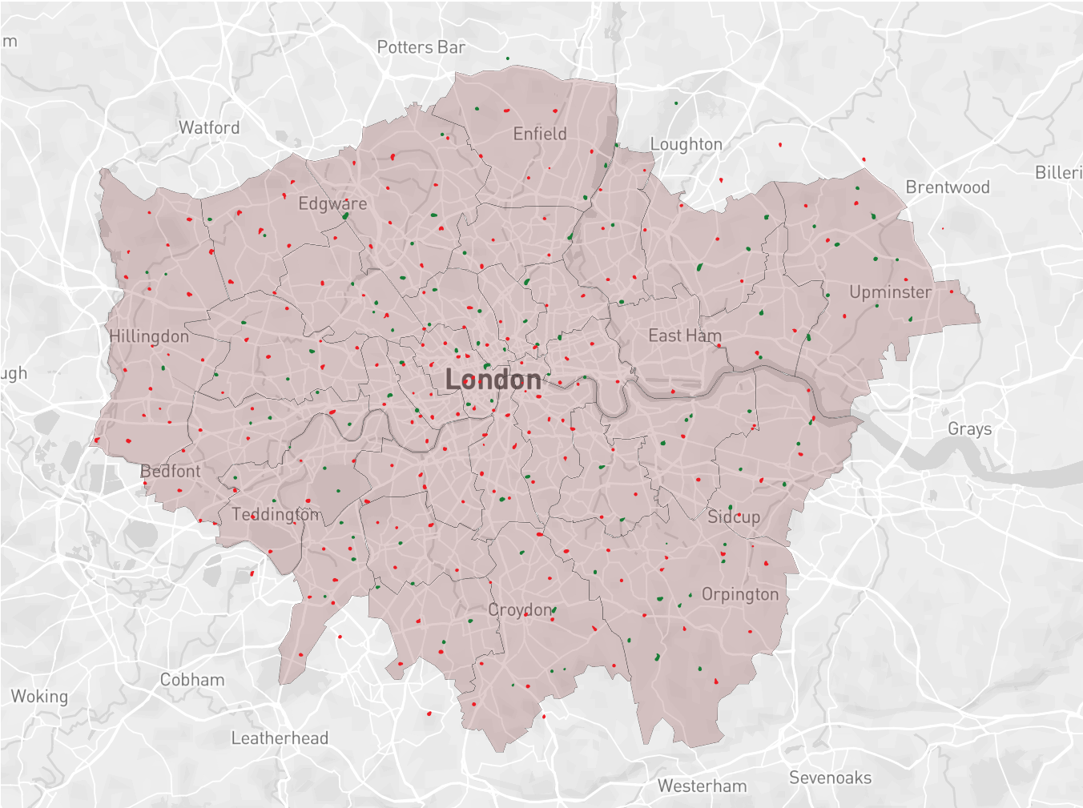
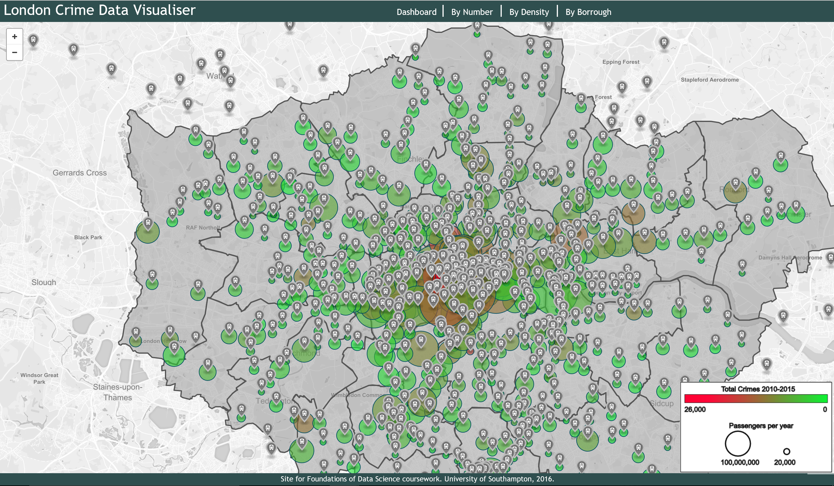
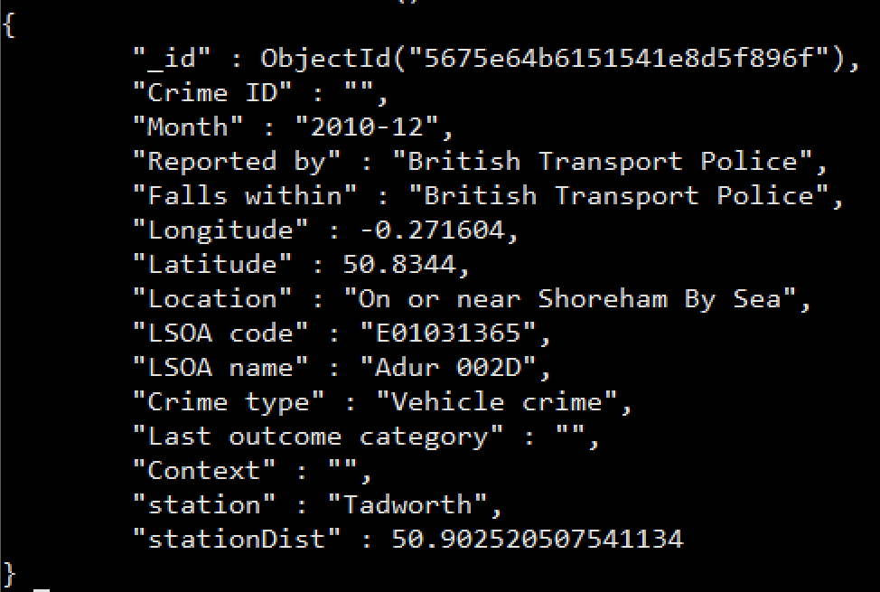
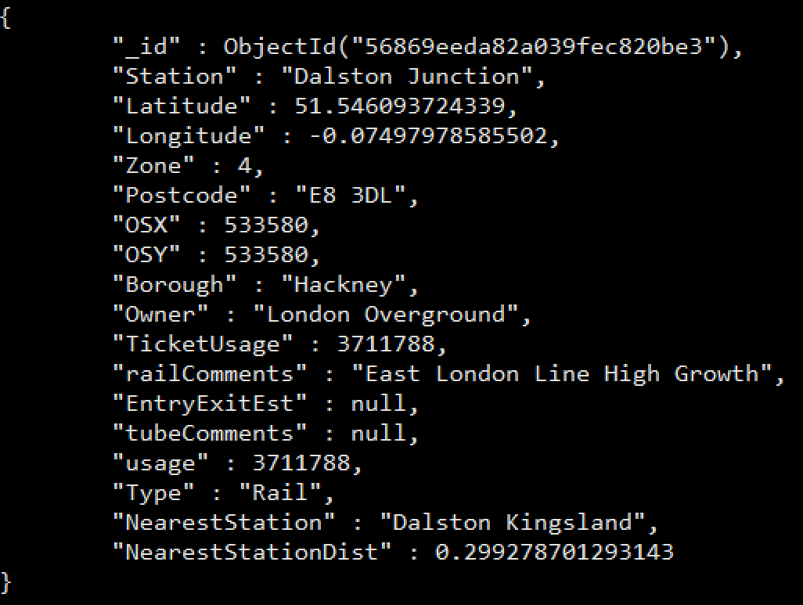
Data Visualisation
Crimes dataset schema
Stations dataset schema

Slide 10
Conclusion

